Slide 1
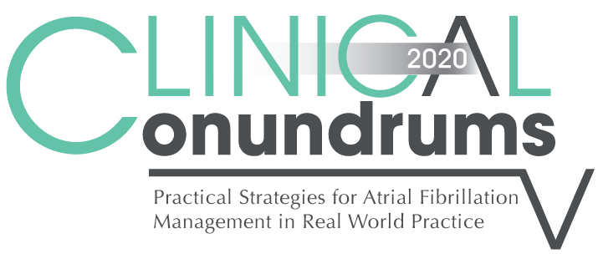



Case 2
CASE 5
Don
Management of Atrial Fibrillation with Gastrointestinal Complications

Slide 2

Learning Objectives
Upon completion of this activity, participants should be able to:
I
Implement best evidence and guidelines in the management of patients with GI bleeding and AF
II
Assess when it is safe to resume oral anticoagulation in patients with AF and GI bleed
III
Evaluate and differentiate the evidence of individual DOACs on risk of GI bleeding in patients with AF
AF = Atrial Fibrillation; GI = Gastrointestinal
PPI = Proton Pump Inhibitor; DOAC = Direct-Acting Oral Anticoagulant
IV
Assess the potential role of PPIs to reduce the risk of a GI bleed
V
Determine the clinical settings where the addition of ASA to a DOAC or to warfarin is worth the added bleeding risk

Slide 3
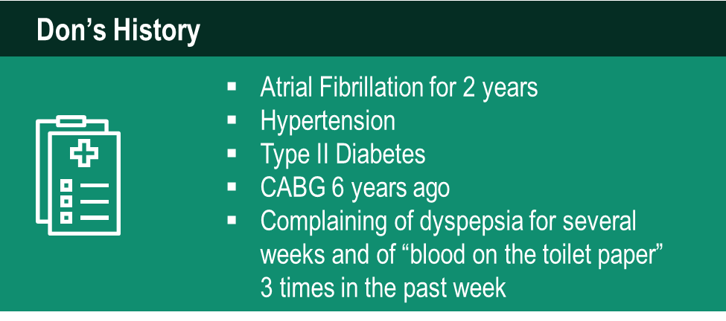

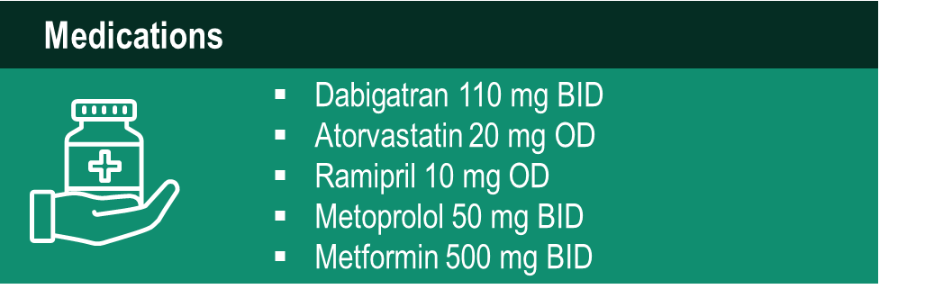
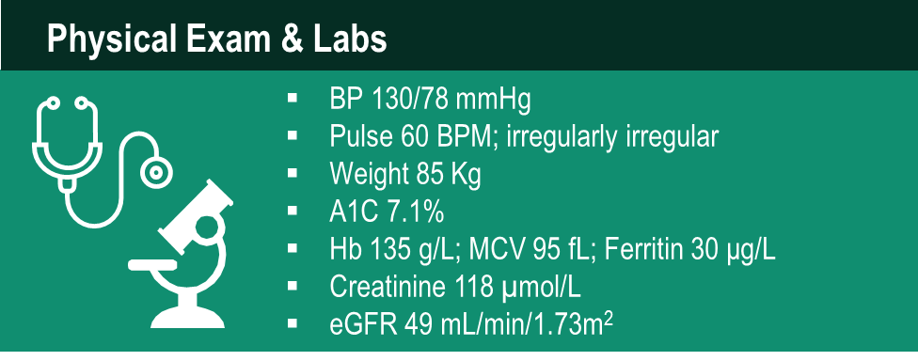
Case 2
Don
82 years old
Notes:
Speaker Notes:
Hb (normal range) : 130-170 g/L (men); 123-157 g/L (women)
MCV (normal range) : 80-100 fL
Ferritin (normal range) : 12-300 ng/ml (men); 12-150 ng/ml (women)

Slide 4
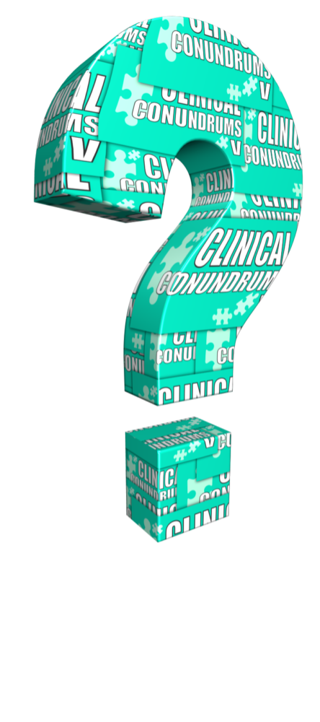
What would you recommend for Don (dyspepsia; rectal bleeding; Hb 135 g/L) ?
Select from one or more of the available options
Continue Dabigatran 110 mg bid
Stop Dabigatran anticoagulation
Switch to ASA 80 mg daily
Switch to Warfarin
Switch to Apixaban
Switch to Edoxaban
Switch to Rivaroxaban
Add a PPI
Refer to a GI specialist to investigate further
Notes:
Speaker Notes:
Correct answers to highlight : 5. 6. 7. (as these DOACs generally are NOT associated with dyspepsia).
Adding a PPI would increase cost, reduce compliance, and may not resolve dyspepsia. George Honos: I would try this if dyspepsia persisted despite a switch to an anti-Xa DOAC.

Slide 5
Stroke Prevention in AF: Clinical Pharmacology and Dosing of DOACs
 | Apixaban | Dabigatran | EDOXABAN | Rivaroxaban
Mechanism of action | Direct Factor Xa inhibitor | Direct thrombin inhibitor | Direct Factor Xa inhibitor | Direct Factor Xa inhibitor
Oral bioavailability | ~50% | ~6.5% | 62% | 80-100%
Pro-drug | No | Yes | No | No
Food effect | No | No | No | Yes (needs to be taken with food)
Renal clearance | ~27% | 85% | 50% | 36% *
Mean half-life (t_{1/2}) | ~12 h | 11-17h | 10-14h | 5-13 h
T_{max} | 3-4 h | 0.5-2 h | 1-2h | 2-4 h
Recommended daily dose | 5 mg BID | 150 mg BID | 60 mg QD | 20 mg QD
Pfizer Canada Inc./BMS Canada. Eliquis (apixaban) Product Monograph, June 16, 2016.
Boehringer Ingelheim Canada Ltd. Pradaxa (dagbatran) Product Monograph. August 11, 2016.
Bayer Inc. Xarelto (rivaroxaban) Product Monograph. July 20, 2015.
Daiichi Sankyp Inc. Lixiana (edoxaban) Product Monograph. November 2, 2016.
* Rivaroxaban is 66% renally cleared and its active metabolite is 36% renally cleared
Notes:
Speaker Notes:
DOACs can be differentiated based on efficacy and bleeding risk in the clinical trials ( and real-world experience available and forthcoming…) with the limitations of indirect clinical comparisons duly acknowledged. DOACs can also be differentiated based on other factors as summarized in this slide. Parameters such as borderline renal function, sensitivity to dyspepsia, irregular food intake, need for blister pack medication preparation by pharmacist, cognitive dysfunction and medication non compliance to BID dosing etc etc can determine selection of the best agent for a given patient!
The Tmax of all DOACs is a short 2-4 hours. This means that, unlike with warfarin, a patient is rapidly anticoagulated within just two hours following a DOAC dose. This has important implications for heparin “bridging” which is no longer required with DOACs as well as for the timing of resumption of DOAC therapy following procedures.
All DOACs share a short 12 hour half-life in the setting of preserved renal function (CrCl > 60 ml/min). This is a major advantage over warfarin which has a half-life of 36 hours or longer depending on hepatic function. Most procedures at intermediate or high bleeding risk can be performed within 1-2 days respectively of withholding a DOAC with additional delay required with renal dysfunction. Moreover, major bleeding can usually be controlled with local and supportive measures as the effect of the DOAC wears off quickly. Specific DOAC antidotes are therefore rarely required.

Slide 6
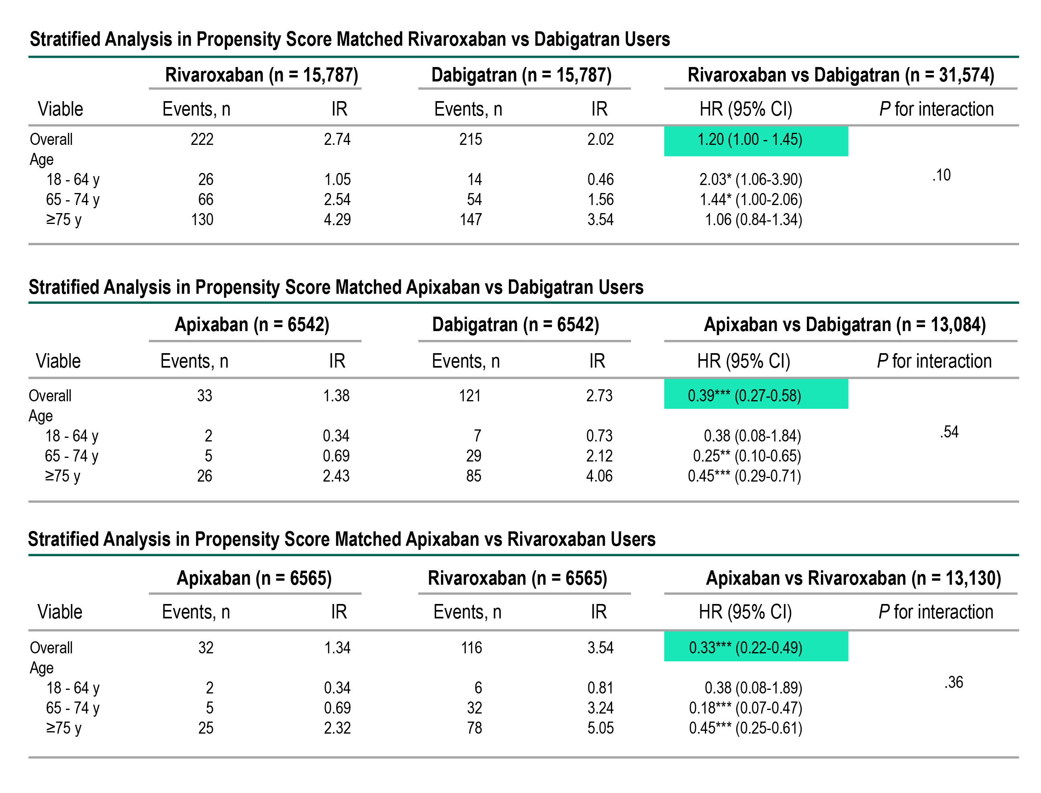
Relative Risks of GI Bleed on DOACs: Propensity-Matched Population-Based Comparison
RIVA
vs
DABI
API
vs
DABI
API
vs
RIVA
Abraham N, et al, Gastroenterology, 2017;152:1014-1022.
Notes:
Speaker Notes:
DOACs can be differentiated based on efficacy and bleeding risk in the clinical trials ( and real-world experience available and forthcoming…) with the limitations of indirect clinical comparisons duly acknowledged. DOACs can also be differentiated based on other factors as summarized in this slide. Parameters such as borderline renal function, sensitivity to dyspepsia, irregular food intake, need for blister pack medication preparation by pharmacist, cognitive dysfunction and medication non compliance to BID dosing etc etc can determine selection of the best agent for a given patient!
The Tmax of all DOACs is a short 2-4 hours. This means that, unlike with warfarin, a patient is rapidly anticoagulated within just two hours following a DOAC dose. This has important implications for heparin “bridging” which is no longer required with DOACs as well as for the timing of resumption of DOAC therapy following procedures.
All DOACs share a short 12 hour half-life in the setting of preserved renal function (CrCl > 60 ml/min). This is a major advantage over warfarin which has a half-life of 36 hours or longer depending on hepatic function. Most procedures at intermediate or high bleeding risk can be performed within 1-2 days respectively of withholding a DOAC with additional delay required with renal dysfunction. Moreover, major bleeding can usually be controlled with local and supportive measures as the effect of the DOAC wears off quickly. Specific DOAC antidotes are therefore rarely required.

Slide 7
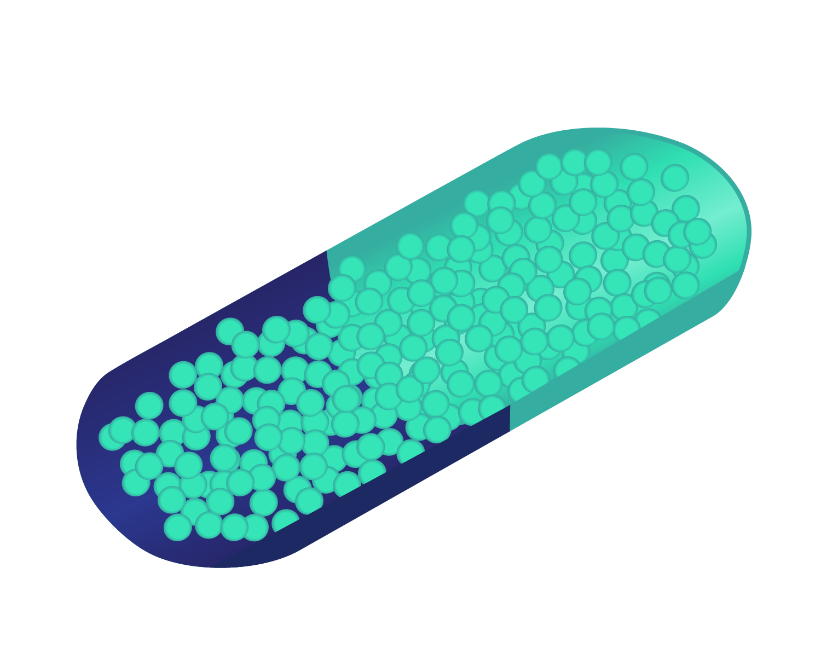


Dabigatran and the Stomach
Dabigatran Capsule
Dabigatran Pellet
Tartaric Acid Core
Dabigatran Coat
Seal Coating
Boehringer Ingelheim Canada Ltd. (2014). Pradaxa Product Monograph..
Notes:
Speaker Notes:
This slide is designed to illustrate the formulation of the dabigatran capsule. Because of the poor bioavailability of dabigatran in the tablet form, it was necessary to create a unique delivery system in order to achieve therapeutic plasma levels of the drug. The dabigatran capsule consists of a gelatin capsule, within which are encased dabigatran pellets. These pellets consist of a tartaric acid core, which are coated with the dabigatran medication. By creating an acidic microenvironment, this facilitates the absorption of the dabigatran in the intestine. While the dabigatran itself is not noxious to the intestine, the tartaric acid may cause microerosions, which may predispose to dyspepsia and/or gastrointestinal bleeding

Slide 8
DOACs versus Warfarin for GI
Bleeding and Dyspepsia Indirect Comparisons from the Clinical Trials
 | Apixaban¹ ^{(eliquis)} | Dabigatran 110² ^{(Pradaxa)} | Dabigatran 150² ^{(Pradaxa)} | EDOXABAN 60 ^{(lixiana)} | Rivaroxaban³ ^{(Xarelto)}
GI Bleed
Dyspepsia | N/A |  |  | N/A
To date there are no head-to-head trials between apixaban, dabigatran, edoxaban and rivaroxaban, therefore comparative efficacy and safety have not been established
Significant Increase vs Warfarin (P < .05)
Non-Significant Difference vs. Warfarin
N/A Information Not Available
Granger et al., NEJM 2011; 365: 981-992
Connolly et al., NEJM 2009; 361: 1139-1151
Patel et al., NEJM 2011; 365: 883-891
Giuliano RP et al NEJM 2013; 369:2091
Notes:
Speaker Notes:
Indirect comparisons should be interpreted with caution because definition of dyspepsia symptoms as well as GI bleeding differ from a study and another.
References:
﻿Connolly SJ, et al; for the RE-LY Steering Committee and Investigators. Dabigatran versus warfarin in patients with atrial fibrillation. N Engl J Med 2009; 361:1139-1151.
Connolly SJ, et al; for the RE-LY Investigators. Newly identified events in the RE-LY trial. N Engl J Med 2010; 363(19):1875-1876.
Patel MR, et al; and the ROCKET AF Steering Committee for the ROCKET AF Investigators. Rivaroxaban versus warfarin in nonvalvular atrial fibrillation. N Engl J Med 2011; 365:883-891.
Granger CB, et al; for the ARISTOTLE Committees and Investigators. Apixaban versus warfarin in patients with atrial fibrillation. N Engl J Med 2011; 365:981-992.

Slide 9
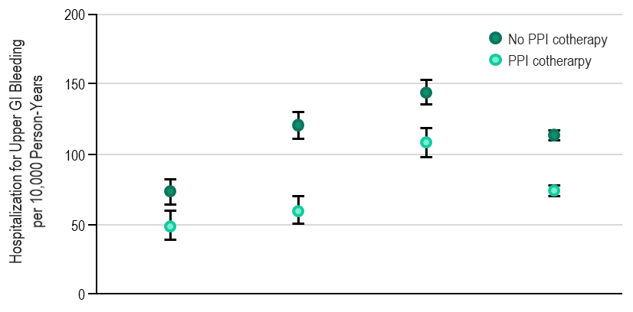
PPI Co-Therapy is Associated with Reduced Hospitalization for Upper GI Bleeding on DOACs and Warfarin
Adjusted Incidence of Hospitalization for Upper GI Bleeding by Individual Oral Anticoagulantsª
Oral Anticoagulants |  | Apixaban | Dabigatran | Rivaroxaban | Warfarin
RD (95% CI) |  | -24 (-38 to -11) | -61 (-75 to -47) | -36 (-49 to -22) | -39 (-44 to -34)
IRR (95% I) |  | 0.66 (0.52 to 0.85) | 0.49 (0.41 to 0.59) | 0.75 (0.68 to 0.84) | 0.65 (0.62 to 0.69)
MEDICARE data (2011-2015) for 1.6 million patients
OAC with and without PPI
Adjusted for 85 covariates possibly related to GI bleed risk
Ray W, et al. JAMA 2018; 320(21):2221-30. doi:10.1001/jama.2018.17242
Notes:
Speaker Notes:

Slide 10
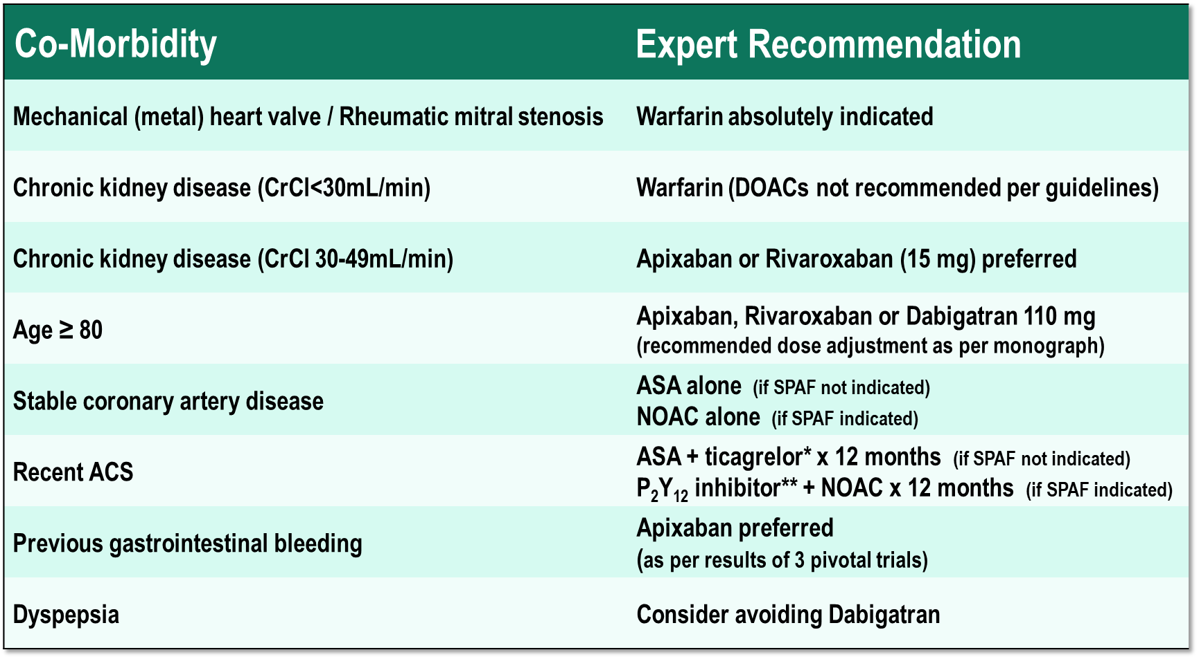
Co-morbidity Considerations in Atrial Fibrillation
* or prasugrel if PCI performed ** clopidogrel generally selected
Pfizer Canada Inc./BMS Canada. Eliquis (apixaban) Product Monograph, June 16, 2016.
Boehringer Ingelheim Canada Ltd. Pradaxa (dagbatran) Product Monograph. August 11, 2016.
Bayer Inc. Xarelto (rivaroxaban) Product Monograph. July 20, 2015.
Cairns Which OAC for which AF Patient Can J Cardiol 2013; :1-8
Granger et al., NEJM 2011; 365: 981-992
Connolly et al., NEJM 2009; 361: 1139-1151
Patel et al., NEJM 2011; 365: 883-891
Macle L et al. 2016 Focused Update of the CCS Management of AF. CJC 32;1170
Notes:
Speaker Notes:
This slide summarizes the Steering Committee members’ consensus of recommendation in personalizing DOAC selection to patient age and co-morbidity
Co-Morbidities. Patients who are at high risk of Stroke should be considered for treatment with dabigatran 150mg po bid, since this is the DOAC associated with the greatest reduction in Stroke compared to warfarin. Patients who are at high risk of Major Bleeding should be considered for treatment with apixaban, since this is the DOAC associated with the greatest reduction in Major Bleeding compared to warfarin. Warfarin is absolutely indicated in patients with Artificial Heart Valves and Rheumatic Mitral Stenosis. DOACs are contraindicated in patients with Stage 4-5 Chronic Kidney Disease (CrCl<30mL/min). Further, because dabigatran is renally cleared, it should be avoided in patients with Stage 3 Chronic Kidney Disease (CrCl 30-49mL/min). Because of increased risk of Major Bleeding in elderly patients, and as per the product monograph, dabigatran 150mg po bid is contraindicated in patients aged 80 or older. A Factor Xa inhibitor is preferred in patients with Coronary Artery Disease (whether recent or stable), noting that ASA may be used as an alterative in low risk patients (as per the 2014 Canadian Cardiovascular Society Guidelines for the Management of Atrial Fibrillation). The combination of an antiplatelet plus an oral anticoagulant is not recommended unless the patient has had recent acute coronary syndrome or a percutaneous coronary intervention, in which case the combination of clopidogrel and an oral anticoagulant may suffice in lieu of triple therapy. Apixaban and rivaroxaban are the only 2 DOACs that are indicated both for stroke prevention in atrial fibrillation and acute venous thromboembolism. Apixaban is the preferred DOAC in patients with a previous history of GI Bleeding, since both dabigatran and rivaroxaban were associated with increased major GI Bleeding when compared to warfarin. Lastly, dabigatran can be associated with dyspepsia, and should be avoided in with dyspepsia, or in patient who develop dyspepsia while on dabigatran.

Slide 11
Expert Position on the Role of a PPI in Anticoagulation and Antiplatelet Management
Observational data suggest that PPIs reduce the risk of GI bleeding on DOACs, and should be considered if prior GI bleeding.
The risk of major bleeding doubles when a DOAC or warfarin is taken with ASA, and triples with dual anti-platelet therapy (DAPT)
Many patients take ASA without a clear indication (e.g. primary CAD prevention). Clinicians should confirm patients on DOACs are not taking unnecessary ‘over the counter’ ASA
PPIs should be considered if patients take DOACs or warfarin with in combination with ASA or DAPT
PPI = Proton Pump Inhibitor
Agewall et al. Eur Heart J 2013 Jun;34(23):1708-13, 1713a-1713b
Notes:
Speaker Notes:
p.1712: Proton pump inhibitors may be useful to alleviate dyspepsia related to dabigatran as well as reduce GI bleeding risk. Current evidence indicates that the mild reduction in dabigatran exposure related to PPI usage does not warrant any dose adjustment.

Slide 12

Case 2
What if Don’s Hb was 120 g/L?
Notes:
Speaker Notes:

Slide 13
What would you recommend for Don?
Select from one or more of the available options
Continue Dabigatran 110 mg bid
Stop Dabigatran anticoagulation
Switch to ASA 80 mg daily
Switch to Warfarin
Switch to Apixaban
Switch to Edoxaban
Switch to Rivaroxaban
Repeat Hb in 1 week
Refer to GI specialist to investigate further
Notes:
Speaker Notes:
Correct Answers: 8 & 9

Slide 14
Risk of Bleeding with Combination Antithrombotic Therapy
ASA alone
Clopidogrel Alone
VKA Alone
ASA + clopidogrel
ASA + VKA
Clopidogrel + VKA
ASA + clopidogrel + VKA
P value not reported
Hazard Ratio (95% CI)
HR 95% CI
1.00 Reference
1.33 1.11-1.59
1.23 0.94-1.61
1.47 1.28-1.69
1.84 1.51-2.23
3.52 2.42-5.11
4.05 3.08-5.33
VKA = Vitamin K Antagonist
CI = Confidence Interval
0.1
0.3
2.0
3.0
10.0
Lancet 2009; 374: 1967-74.
Notes:
Speaker Notes:

Slide 15
AVERROES
Study Design
Primary objective: To establish the superiority of apixaban 5mg bid to ASA 81-324 mg OD to prevent stroke or systemic embolism
Mean of 1.1 years of follow up
Apixaban 5 mg BID
AF and ≥1 risk factor, and demonstrated or expected unsuitable for VKA
2.5 mg BID in selected patients
R
5999 patients
Double-Blind
ASA (81-324 mg/d)
N Engl J Med 2011; 364: 806-17.
Notes:
Speaker Notes:

Slide 16
AVERROES
Major Bleeding
Data represents %/year
 | Apixaban | ASA | RR | 95% CI | P-value
Number of patients (n) | 2808 | 2791
Major bleeding | 1.4 | 1.2 | 1.13 | 0.74-1.75 | 0.57
- Minor - Fatal - Intracranial | 6.3 0.1 0.4 | 5.0 0.2 0.4 | 1.24 0.67 0.85 | 1.00-1.53 0.19-2.37 0.38-1.90 | 0.05 0.53 0.69
N Engl J Med 2011; 364: 806-17.
Notes:
Speaker Notes:
No significant difference in risk of major / fatal / intracranial bleeding between apixaban and ASA.
24% borderline significant (P 0.05) increase in minor bleeds with apixaban vs ASA

Slide 17
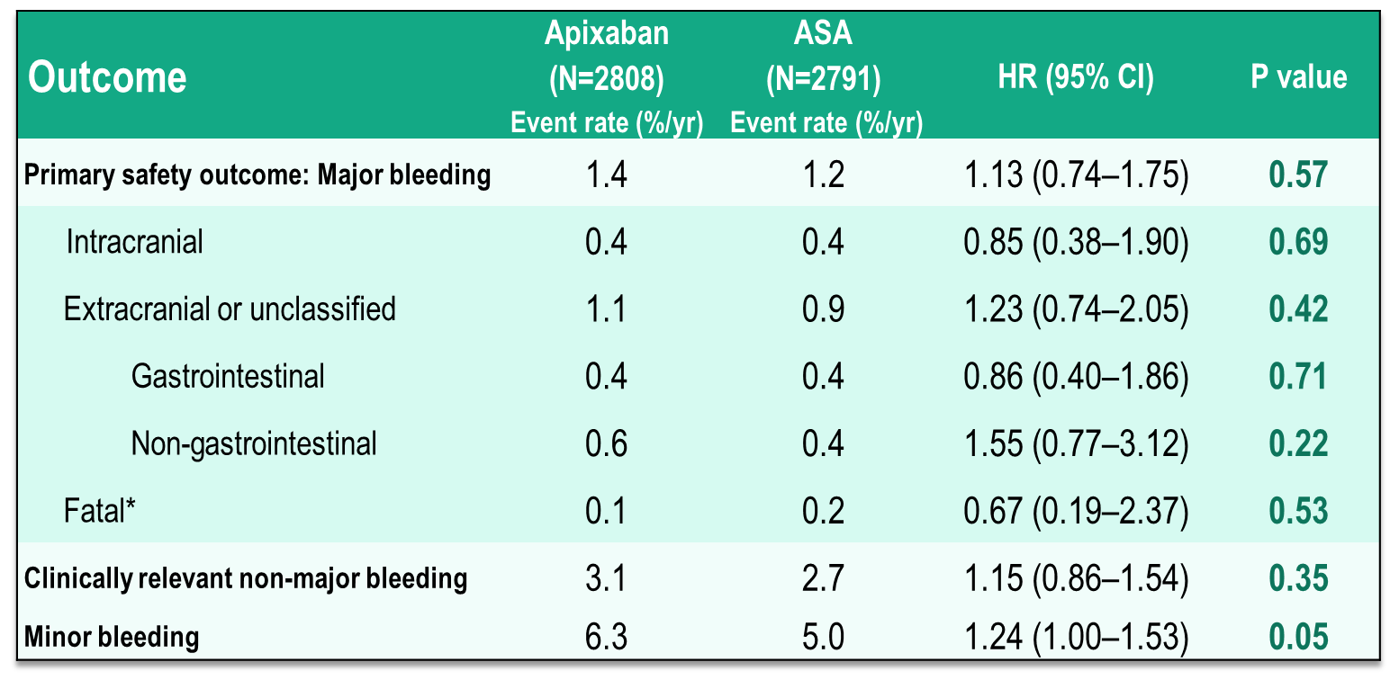
AVERROES
Main Safety Outcomes
*Bleeding events were reported as fatal by the investigator and were confirmed at adjudication
Connolly et al. N Engl J Med 2011;364:806-17
Notes:
Speaker Notes:
No significant difference in risk of major / fatal / intracranial / gastrointestinal/ clinically relevant non-major bleeding between apixaban and ASA.
24% borderline significant (P 0.05) increase in minor bleeds with apixaban vs ASA

Slide 18
AVERROES
Patients on Apixaban were less likely to discontinue the drug than patients on ASA
DSMB terminated study early due to a clear benefit (>4 SD) for Apixaban
Permanent discontinuation rate at 2 years (%/yr)
HR=0.88 (0.78–0.99), P=0.03
20.5%
17.9%
% of patients discontinuing study drug before end of study
Apixaban (n=2808)
ASA (n=2791)
Significantly fewer apixaban patients than ASA patients had a serious adverse event: 22% vs. 27%, P<0.001
DSMB, Data safety monitoring board; SD, Standard deviation
Connolly et al. N Engl J Med 2011;364:806-17
Notes:
Speaker Notes:
In AVERROES (Apixaban vs. Acetylsalicylic Acid to Prevent Stroke in Atrial Fibrillation Patients who have Failed or are Unsuitable for Vitamin K Antagonist Treatment), apixaban was superior to aspirin for stroke prevention and carried a similar bleeding risk. Roughly 1 year after treatment, fewer patients who received apixaban than patients who received aspirin were hospitalized for cardiovascular reasons [59]. This reduction was driven primarily by fewer stroke-related hospitalizations
The data and safety monitoring committee reviewed the results of the first planned interim analysis of efficacy on February 19, 2010, at which time 104 events had occurred, and observed a treatment benefit in favor of apixaban for the primary outcome that exceeded 4 SD. The results of a confirmatory analysis were reviewed on May 28, 2010, at which time the P value was 0.000002, and study termination was recommended.
Most patients received apixaban or an apixaban placebo at a dose of 5 mg twice a day. A daily dose of ≤162 mg of ASA or ASA placebo was used in the case of 91% of the patients in both the apixaban and ASA groups.
At 2 years, the rates of permanent discontinuation of the study medication were 17.9% per year in the apixaban group and 20.5% per year in the ASA group; the risk of permanent discontinuation was 12% lower in the apixaban group than in the ASA group (hazard ratio with apixaban, 0.88; 95% CI, 0.78 to 0.99; P=0.03).

Slide 19
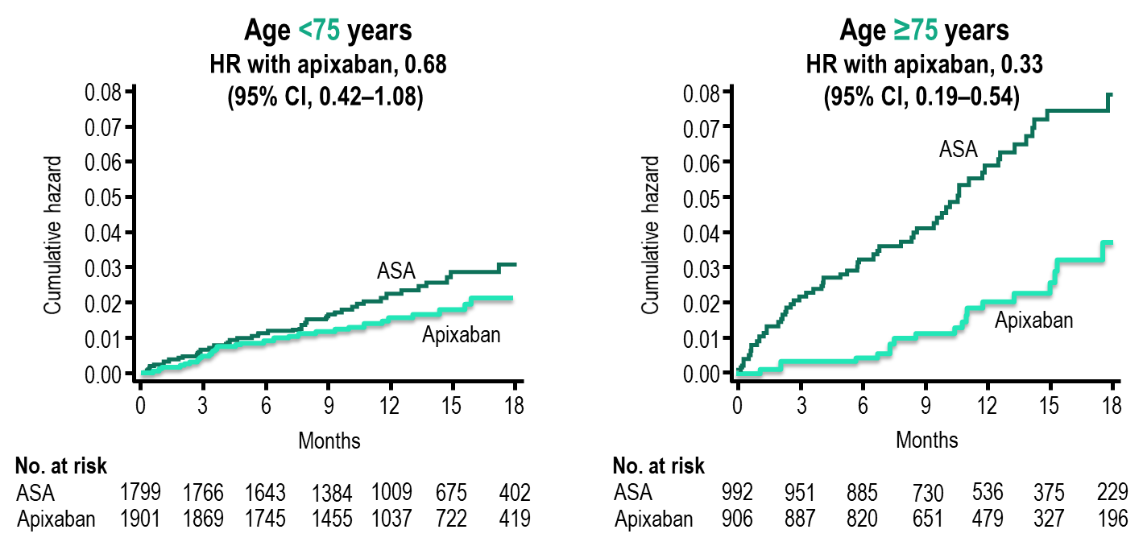
AVERROES: Above and below 75 years of age Stroke Prevention
Cumulative hazard rates of stroke in ASA and apixaban
treatment groups, in patients <75 years or ≥ 75 years old.
P-value for interaction = 0.04
Age and Ageing 2015: 0:1-7 doi: 10.1093/ageing/afv156
Notes:
Speaker Notes:
Increased efficacy of apixaban in the elderly
In this paper we have reported evidence that for stroke prevention,
the efﬁcacy of apixaban in comparison to aspirin
increases with age. In patients =75 years, there was a greater
relative risk reduction with apixaban (HR 0.33, 95% CI
0.18–0.56) compared with younger patients (HR 0.68, 95%
CI 0.42–1.08; P-value for interaction = 0.04) (Figure 1). The
number needed to treat (NNT, calculated as 1/[absolute risk
reduction]) per year to prevent a stroke was 26 in patients
=75 compared with a NNT of 143 in younger patients. In
contrast, the relative efﬁcacy of aspirin to prevent ischaemic
stroke decreases as patients with AF age and appears ineffectual
as patients enter their eighth decade [8]. The beneﬁtof
apixaban with advancing age appears to be due to a rapidly
increasing stroke risk on aspirin, whereas the stroke risk on
apixaban is relatively consistent across age groups (Figure 2A).
In the absence of a comparator group with no antiplatelets or
anticoagulants, it is not possible to determine conclusively
from our data if this is due to a loss of efﬁcacy of aspirin with
age or an increase in efﬁcacy with apixaban. However, as most
elderly patients not anticoagulated will be prescribed aspirin,
the ﬁndings of this analysis are clinically relevant.

Slide 20
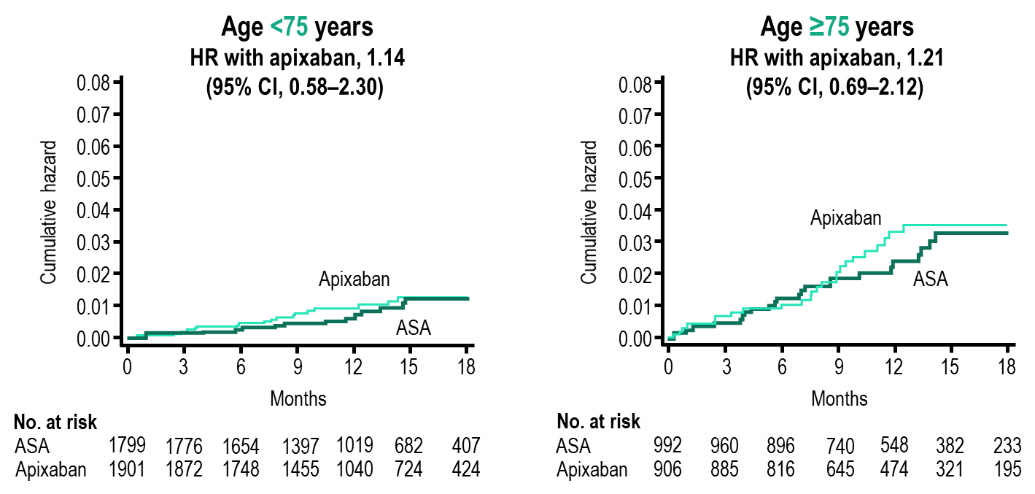
AVERROES: Above and below 75 years of age Bleeding
Cumulative hazard rates of major bleeding in ASA and apixaban
treatment groups, in patients <75 years or ≥ 75 years old.
P-value not available
Age and Ageing 2015: 0:1-7 doi: 10.1093/ageing/afv156
Notes:
Speaker Notes:
Risk of bleeding with initiation of apixaban
Patients enrolled onto AVERROES were not anticoagulated
with vitamin K antagonist therapy either because it was unsuitable
or expected to be unsuitable. Multiple physician and
patient factors were listed for patients not being suitable for
VKA but most patients were unsuitable for multiple reasons
(Supplementary data, Table S4, available in Age and Ageing
online). A large proportion of older patients (42.6%) had
previously failed VKA therapy and of that group, 9.5% had
serious bleeding due to VKA therapy.
In general, apixaban has a similar major bleeding rate to
aspirin in patients who were previously not deemed suitable
for anticoagulation with VKA. The risk of bleeding increased
on both treatments with age (Figure 2B). However even in
the very elderly, apixaban was as safe as aspirin in regards to
bleeding. For intracranial haemorrhage, there is some evidence
that apixaban is safer than aspirin in patients =85
years though absolute event rates were low.

Slide 21
Co-morbidity Considerations in Atrial Fibrillation
* or prasugrel if PCI performed ** clopidogrel generally selected
Pfizer Canada Inc./BMS Canada. Eliquis (apixaban) Product Monograph, June 16, 2016.
Boehringer Ingelheim Canada Ltd. Pradaxa (dagbatran) Product Monograph. August 11, 2016.
Bayer Inc. Xarelto (rivaroxaban) Product Monograph. July 20, 2015.
Cairns Which OAC for which AF Patient Can J Cardiol 2013; :1-8
Granger et al., NEJM 2011; 365: 981-992
Connolly et al., NEJM 2009; 361: 1139-1151
Patel et al., NEJM 2011; 365: 883-891
Macle L et al. 2016 Focused Update of the CCS Management of AF. CJC 32;1170
Notes:
Speaker Notes:
This slide summarizes the Steering Committee members’ consensus of recommendation in personalizing DOAC selection to patient age and co-morbidity
Co-Morbidities. Patients who are at high risk of Stroke should be considered for treatment with dabigatran 150mg po bid, since this is the DOAC associated with the greatest reduction in Stroke compared to warfarin. Patients who are at high risk of Major Bleeding should be considered for treatment with apixaban, since this is the DOAC associated with the greatest reduction in Major Bleeding compared to warfarin. Warfarin is absolutely indicated in patients with Artificial Heart Valves and Rheumatic Mitral Stenosis. DOACs are contraindicated in patients with Stage 4-5 Chronic Kidney Disease (CrCl<30mL/min). Further, because dabigatran is renally cleared, it should be avoided in patients with Stage 3 Chronic Kidney Disease (CrCl 30-49mL/min). Because of increased risk of Major Bleeding in elderly patients, and as per the product monograph, dabigatran 150mg po bid is contraindicated in patients aged 80 or older. A Factor Xa inhibitor is preferred in patients with Coronary Artery Disease (whether recent or stable), noting that ASA may be used as an alterative in low risk patients (as per the 2014 Canadian Cardiovascular Society Guidelines for the Management of Atrial Fibrillation). The combination of an antiplatelet plus an oral anticoagulant is not recommended unless the patient has had recent acute coronary syndrome or a percutaneous coronary intervention, in which case the combination of clopidogrel and an oral anticoagulant may suffice in lieu of triple therapy. Apixaban and rivaroxaban are the only 2 DOACs that are indicated both for stroke prevention in atrial fibrillation and acute venous thromboembolism. Apixaban is the preferred DOAC in patients with a previous history of GI Bleeding, since both dabigatran and rivaroxaban were associated with increased major GI Bleeding when compared to warfarin. Lastly, dabigatran can be associated with dyspepsia, and should be avoided in with dyspepsia, or in patient who develop dyspepsia while on dabigatran.

Slide 22
Case 2
What if Don’s Hb was 100 g/L?
Notes:
Speaker Notes:

Slide 23
What would you recommend for Don?
Select from one or more of the available options
Continue Dabigatran 110 mg bid
Stop Dabigatran anticoagulation
Switch to ASA 80 mg daily
Switch to Warfarin
Switch to Apixaban
Switch to Edoxaban
Switch to Rivaroxaban
Repeat Hb in 1 week
Refer to GI specialist to investigate further
Send to ER
Notes:
Speaker Notes:
No intention for correct answer but discussion with several correct answers (ie 5 + 1 for instance)

Slide 24
What is the bleeding risk for a diagnostic gastroscopy or
colonoscopy with biopsy?
Select from one or the available options
Low Risk
Moderate Risk
High Risk
Notes:
Speaker Notes:
Answers provided on slide 26

Slide 25
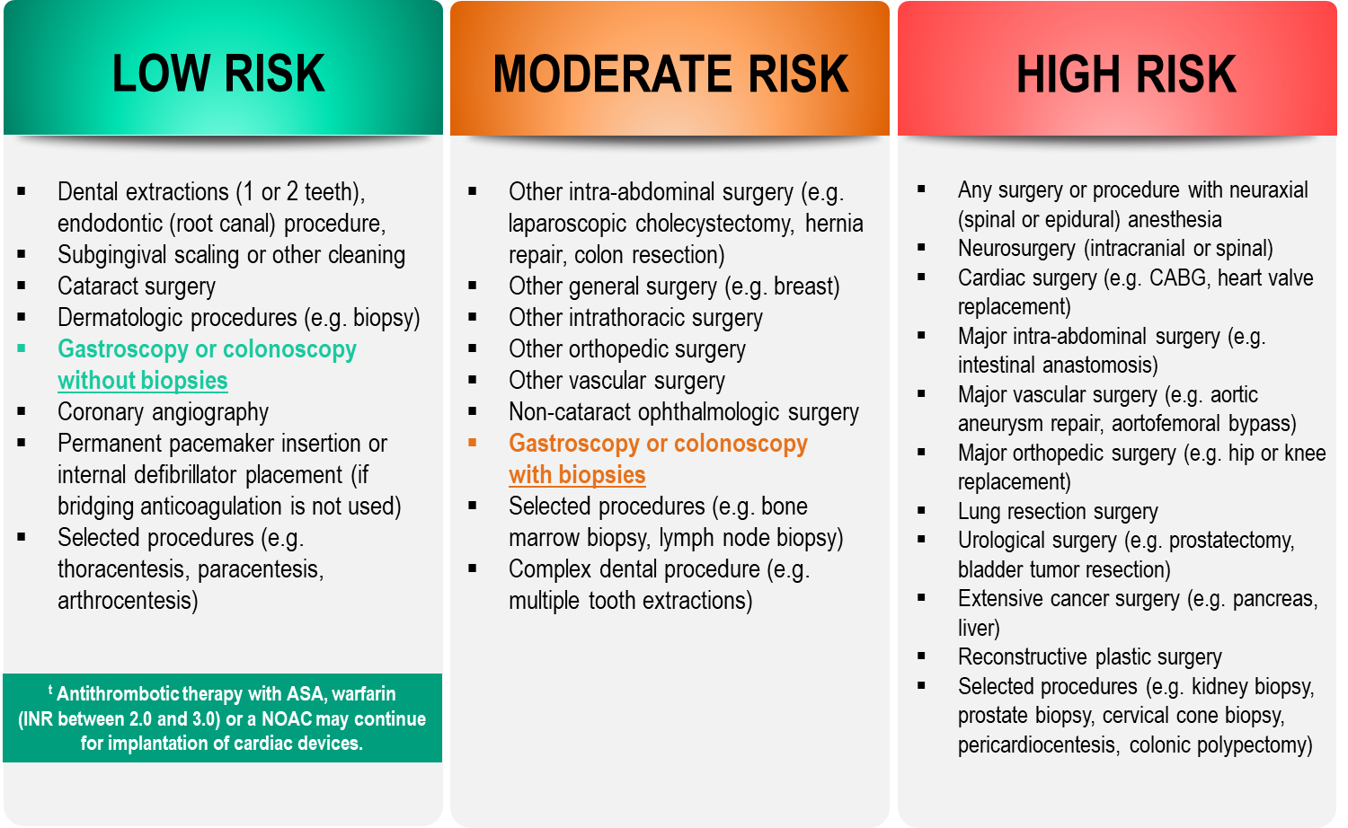
Bleeding Risks for Invasive /
Surgical Procedures
CCS AF Guidelines. Can J Cardiol. 2016; 32: 1170-1185
Thrombosis Canada Clinical Guide. Warfarin: Peri-Operative Management. www.thrombosiscanada.ca
BRUISE-CONTROL 2 – Presented at the AHA Scientific Sessions, Anaheim CA - Nov 2017
Notes:
Speaker Notes:
Steering committee recommendation; In addition to the bleeding risk of a procedure, physicians should consider co-morbid conditions that might exacerbate the bleeding risk (e.g. advanced age, renal or liver impairment).
Many invasive and surgical procedures carry but a very low to low risk of bleeding – DOACs may be held only briefly or even continued without interruption during such procedures as will be discussed in case #2
Antithrombotic therapy with warfarin but not a DOAC can be safely continued pre-post pacemaker or ICD insertion
DOACs never need to be bridged with subcutaneous heparin peri-invasive or surgical procedures due to their short duration of action
REFERENCES:
Douketis JD, Spyropoulos AC, Spencer FA, et al. Perioperative management of antithrombotic therapy: Antithrombotic Therapy and Prevention of Thrombosis, 9th ed: American College of Chest Physicians Evidence-Based Clinical Practice Guidelines. Chest. 2012;141(2 Suppl):e326S - 50S.
Verma A, Cairns JA, Mitchell LB, et al. 2014 focused update of the Canadian Cardiovascular Society
Guidelines for the management of atrial fibrillation. Can J Cardiol. 2014;30(10):1114-1130.
Horlocker TT, Wedel DJ, Rowlingson JC, et al. Regional anesthesia in the patient receiving antithrombotic or thrombolytic therapy: American Society of Regional Anesthesia and Pain Medicine Evidence-Based Guidelines (Third Edition). Reg Anesth Pain Med. 2010;35(1):64-101.
XARELTO-PM-ENG-10JUL2014-172618.pdf. http://www.bayer.ca/files/XARELTO-PM-ENG-10JUL2014-
172618.pdf? Accessed 11 Nov 2014
Pfizer Canada Inc Eliquis Product Monograph. http://www.pfizer.ca/en/our_products/products/monograph/313. Accessed 11 Nov 2014
Boehringer Ingelheim Canada Ltd. (2014) Pradaxa Product Monograph. http://www.boehringer- ingelheim.ca/content/dam/internet/opu/ca_EN/documents/humanhealth/product_monograph/Prad axaPMEN.pdf. Accessed 11 Nov 2014
Thrombosis Canada. http://thrombosiscanada.ca/

Slide 26
What is the bleeding risk for a diagnostic gastroscopy or
colonoscopy with biopsy?
Select from one or the available options
Low Risk – Diagnostic Gastroscopy
Moderate Risk – Colonoscopy with Biopsy
High Risk
Notes:
Speaker Notes:
Correct answers: 1. Low Risk – Diagnostic Gastroscopy & 2. Moderate Risk – Colonoscopy with Biopsy

Slide 27
What is the bleeding risk for a colonoscopy with possible polypectomy?
Select from one or the available options
Low Risk
Moderate Risk
High Risk
Notes:
Speaker Notes:
Answers provided on slide 29

Slide 28
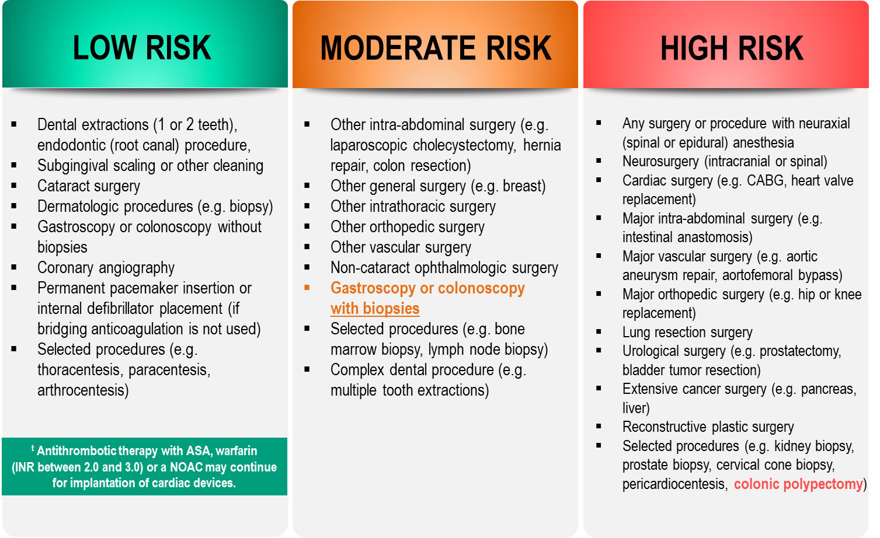
Bleeding Risks for Invasive /
Surgical Procedures
CCS AF Guidelines. Can J Cardiol. 2016; 32: 1170-1185
Thrombosis Canada Clinical Guide. Warfarin: Peri-Operative Management. www.thrombosiscanada.ca
BRUISE-CONTROL 2 – Presented at the AHA Scientific Sessions, Anaheim CA - Nov 2017
Notes:
Speaker Notes:
Steering committee recommendation; In addition to the bleeding risk of a procedure, physicians should consider co-morbid conditions that might exacerbate the bleeding risk (e.g. advanced age, renal or liver impairment).
Many invasive and surgical procedures carry but a very low to low risk of bleeding – DOACs may be held only briefly or even continued without interruption during such procedures as will be discussed in case #2
Antithrombotic therapy with warfarin but not a DOAC can be safely continued pre-post pacemaker or ICD insertion
DOACs never need to be bridged with subcutaneous heparin peri-invasive or surgical procedures due to their short duration of action
REFERENCES:
Douketis JD, Spyropoulos AC, Spencer FA, et al. Perioperative management of antithrombotic therapy: Antithrombotic Therapy and Prevention of Thrombosis, 9th ed: American College of Chest Physicians Evidence-Based Clinical Practice Guidelines. Chest. 2012;141(2 Suppl):e326S - 50S.
Verma A, Cairns JA, Mitchell LB, et al. 2014 focused update of the Canadian Cardiovascular Society
Guidelines for the management of atrial fibrillation. Can J Cardiol. 2014;30(10):1114-1130.
Horlocker TT, Wedel DJ, Rowlingson JC, et al. Regional anesthesia in the patient receiving antithrombotic or thrombolytic therapy: American Society of Regional Anesthesia and Pain Medicine Evidence-Based Guidelines (Third Edition). Reg Anesth Pain Med. 2010;35(1):64-101.
XARELTO-PM-ENG-10JUL2014-172618.pdf. http://www.bayer.ca/files/XARELTO-PM-ENG-10JUL2014-
172618.pdf? Accessed 11 Nov 2014
Pfizer Canada Inc Eliquis Product Monograph. http://www.pfizer.ca/en/our_products/products/monograph/313. Accessed 11 Nov 2014
Boehringer Ingelheim Canada Ltd. (2014) Pradaxa Product Monograph. http://www.boehringer- ingelheim.ca/content/dam/internet/opu/ca_EN/documents/humanhealth/product_monograph/Prad axaPMEN.pdf. Accessed 11 Nov 2014
Thrombosis Canada. http://thrombosiscanada.ca/

Slide 29
What is the bleeding risk for a colonoscopy with possible polypectomy?
Select from one or the available options
Low Risk
Moderate Risk – Colonoscopy with Biopsy
High Risk - colonoscopy with possible polypectomy
Notes:
Speaker Notes:
Correct answers: 2. Moderate Risk – Colonoscopy with Biopsy & 3. High Risk - colonoscopy with possible polypectomy

Slide 30
Case 2
Let’s assume that Don was maintained on dabigatran 110 mg BID and that he has an upcoming colonoscopy with possible polypectomy
Notes:
Speaker Notes:

Slide 31
What would you advise Don to do about to do about his Dabigatran for his colonoscopy with possible polypectomy ?
Select from one of the following:
Continue his Dabigatran uninterrupted
Stop Dabigatran 1 day before procedure
Stop Dabigatran 3 days before procedure
Stop Dabigatran 5 days before procedure
Stop Dabigatran one week before procedure
Notes:
Speaker Notes:
Correct Answer: 4 (Stop Dabigatran 5 days before procedure)

Slide 32

CCS 2016 Clinical
Practice Recommendations
RECOMMENDATION
We recommend that the interruption of anticoagulant therapy in a patient with AF/AFL will be necessary for most procedures with an intermediate or high risk of major bleeding
(Strong Recommendation, Low-Quality Evidence)
AF = Atrial Fibrillation
AFL = Atrial Flutter
2016 Focused Update of the Canadian Cardiovascular Society Guidelines for the Management of Atrial Fibrillation
Macle, Laurent et al. Canadian Journal of Cardiology , Volume 32 , Issue 10 , 1170 - 1185
Notes:
Speaker Notes:

Slide 33
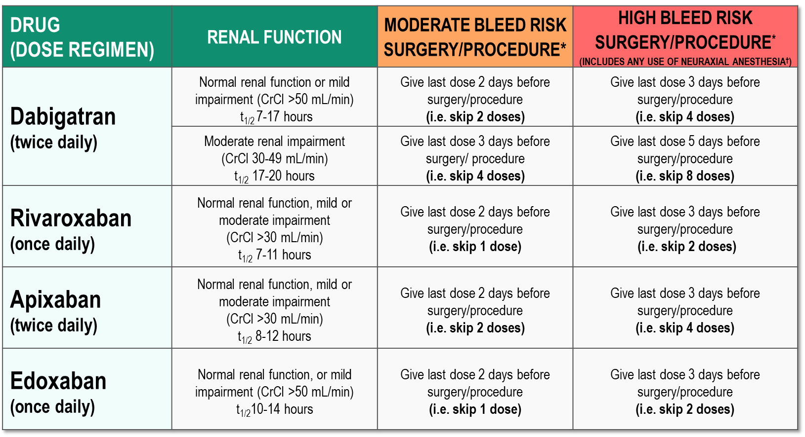
Peri-Operative Guide
*No anticoagulant taken on the day of surgery/procedure.
†Neuraxial procedures include spinal anesthesia, epidural catheter insertion and epidural catheter removal.
2017 Thrombosis Canada
Notes:
Speaker Notes:
Patients with Impaired Renal Function: For patients with severe renal dysfunction (CrCl <30 mL/min) who are generally ineligible for DOACs, peri-operative management is unclear.

Slide 34
Stroke Prevention in AF: Clinical Pharmacology and Dosing of DOACs
 | Apixaban | Dabigatran | EDOXABAN | Rivaroxaban
Mechanism of action | Direct Factor Xa inhibitor | Direct thrombin inhibitor | Direct Factor Xa inhibitor | Direct Factor Xa inhibitor
Oral bioavailability | ~50% | ~6.5% | 62% | 80-100%
Pro-drug | No | Yes | No | No
Food effect | No | No | No | Yes (needs to be taken with food)
Renal clearance | ~27% | 85% | 50% | 36% *
Mean half-life (t_{1/2}) | ~12 h | 11-17h | 10-14h | 5-13 h
T_{max} | 3-4 h | 0.5-2 h | 1-2h | 2-4 h
Recommended daily dose | 5 mg BID | 150 mg BID | 60 mg QD | 20 mg QD
Pfizer Canada Inc./BMS Canada. Eliquis (apixaban) Product Monograph, June 16, 2016.
Boehringer Ingelheim Canada Ltd. Pradaxa (dagbatran) Product Monograph. August 11, 2016.
Bayer Inc. Xarelto (rivaroxaban) Product Monograph. July 20, 2015.
Daiichi Sankyp Inc. Lixiana (edoxaban) Product Monograph. November 2, 2016.
* Rivaroxaban is 66% renally cleared and its active metabolite is 36% renally cleared
Notes:
Speaker Notes:
DOACs can be differentiated based on efficacy and bleeding risk in the clinical trials ( and real-world experience available and forthcoming…) with the limitations of indirect clinical comparisons duly acknowledged. DOACs can also be differentiated based on other factors as summarized in this slide. Parameters such as borderline renal function, sensitivity to dyspepsia, irregular food intake, need for blister pack medication preparation by pharmacist, cognitive dysfunction and medication non compliance to BID dosing etc etc can determine selection of the best agent for a given patient!
The Tmax of all DOACs is a short 2-4 hours. This means that, unlike with warfarin, a patient is rapidly anticoagulated within just two hours following a DOAC dose. This has important implications for heparin “bridging” which is no longer required with DOACs as well as for the timing of resumption of DOAC therapy following procedures.
All DOACs share a short 12 hour half-life in the setting of preserved renal function (CrCl > 60 ml/min). This is a major advantage over warfarin which has a half-life of 36 hours or longer depending on hepatic function. Most procedures at intermediate or high bleeding risk can be performed within 1-2 days respectively of withholding a DOAC with additional delay required with renal dysfunction. Moreover, major bleeding can usually be controlled with local and supportive measures as the effect of the DOAC wears off quickly. Specific DOAC antidotes are therefore rarely required.

Slide 35
When would you tell Don to resume his DOAC post polypectomy?
Select from one of the following:
Immediately after the procedure
The next day
In 2-3 days
When the gastroenterologist recommends
Never (too high a risk of recurrent GI bleed)
Notes:
Speaker Notes:
Correct answers: Correct Answer: 3 & 4

Slide 36
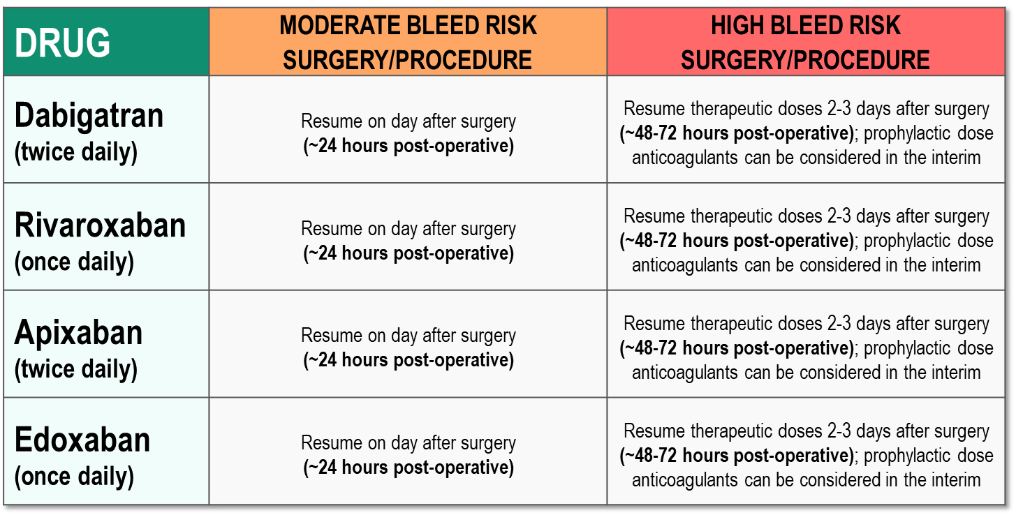
Post-Operative Guide
2017 Thrombosis Canada
Notes:
Speaker Notes:

Slide 37
Case 2
Don
82 years old
Don’s colonoscopy report diagnosed diverticulosis.
He was hospitalized three months later for a major lower GI bleed.
His dabigatran was stopped and he received blood transfusions.
He returns to your office 3 weeks later…
Notes:
Speaker Notes:

Slide 38
What would be your recommendation for Don following his diagnosis of diverticular hemorrhage?
Select from one or more of the available options
Continue Dabigatran 110 mg BID
Stop Dabigatran and start Apixaban 2.5 mg BID
Stop Dabigatran and start Apixaban 5 mg BID
Stop Dabigatran and start Rivaroxaban 15 mg OD
Stop Dabigatran and start Rivaroxaban 20 mg OD
Stop Dabigatran and start Edoxaban 30 mg OD
Stop Dabigatran and start Edoxaban 60 mg OD
Stop Dabigatran and start Warfarin (target INR 2-3)
Stop Dabigatran and start ASA 80 mg daily
Long term cessation of anticoagulation
Notes:
Speaker Notes:
Answer 2 – would be selected by most cardiologists

Slide 39
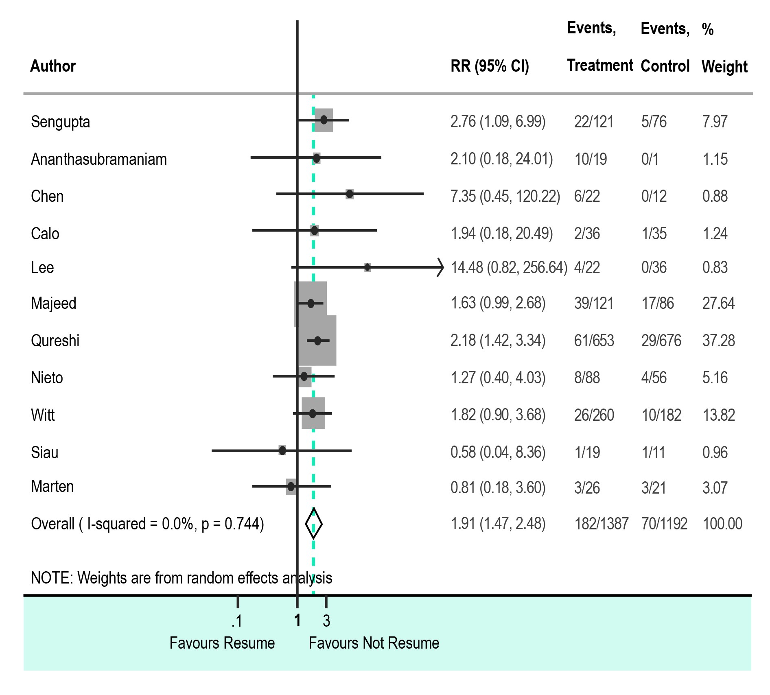
Resumption of DOAC or Warfarin after Anticoagulant-Related GI Bleeding:
Systematic Review and Meta-Analysis
Little D. Thombosis Research 2019;175:102-9
Notes:
Speaker Notes:
12 observational studies (N=3098)
Restarting DOAC/warfarin increases bleeding:
RR 1.91 (95% CI 1.47-2.48)
but also decreases thromboembolism
RR 0.30 (95% CI 0.13-0.68)
and reduces mortality:
RR 0.51 (95% CI 0.38-0.70)
Thus, while there is no clear guidance on time to resumption of anticoagulants after GI bleeding, they should not be delayed unnecessarily

Slide 40
Resumption of DOAC or Warfarin after Anticoagulant-Related GI Bleeding:
Systematic Review and Meta-Analysis
40% of oral anticoagulant (OAC)-related bleeds are gastrointestinal (GI) bleeds.
OAC is discontinued in 41–51% of patients after a GI bleed.
Resuming OAC is associated with an increased risk of recurrent GI bleeding.
Resuming OAC is associated with a reduced risk of thromboembolism and mortality.
Little D. Thombosis Research 2019;175:102-9
Notes:
Speaker Notes:

Slide 41
What if Don had sub-acute bleeding from small bowel angiodysplasia?
Select from one or more of the available options
Continue Dabigatran 110 mg BID
Start Apixaban 2.5 mg BID
Start Apixaban 5 mg BID
Start Rivaroxaban 15 mg OD
Start Rivaroxaban 20 mg OD
Start Edoxaban 30 mg OD
Start Edoxaban 60 mg OD
Start Warfarin (target INR 2-3)
Start ASA 80 mg daily
Long term cessation of anticoagulation
Notes:
Speaker Notes:
Correct answer 10. Should be considered here but should individualize based on gastroenterologists input

Slide 42

Key Messages
It is important to modify bleeding risk factors, especially with a recent GI bleed
GI bleeding is NOT a contraindication to subsequent anticoagulation in most cases, and unnecessary delay can have negative consequences
Evidence from indirect comparisons suggests that rates of dyspepsia and GI bleeding differ among DOACs
Observational data suggest that PPI co-therapy is associated with a reduced risk of GI bleed among patients on DOACs
In general, DOACs should be stopped for 1-2 days prior to procedures with a moderate bleeding risk and for 2-3 days prior to procedures with a high bleeding risk
SPAF = Stroke Prevention in Atrial Fibrillation
Notes:
Speaker Notes:

